Slide 1
2023 NATIONAL YOUTH RISK BEHAVIOR SURVEY Co-Occurring Adverse Experiences & Protective Factors in Adolescent Suicidality
A survey-weighted analysis of self-reported adversity, protective behaviours, and suicide-risk outcomes among U.S. high school students
Jacinta · Aliya · Destiny · Albert · Terence · Francis · Bernard

Slide 2
Table of contents
01
Background
04
Recommendations
An introduction to our project, key aims and objectives
A closer look at our dataset refinements and further analysis
02
Methodology
05
Conclusion
An overview of our approach to the data source, and methods of collaborative working (GitHub, Teams, Google Drive)
A summary of our conclusions, limitations, and next steps
03
Key findings
05
Q&A
A breakdown of key results across the four suicide outcomes
An opportunity to further explore our project and address your questions

Slide 3
01
Introduction
An introduction to our project, key aims and objectives

Slide 4
Background
2021
2022
2023
2026
Emergency
Hearing
Evidence
Investigation
American Academy of
Child and Adolescent
Psychiatry declared a
"national emergency in
child and adolescent mental health" in the U.S.
The U.S. Senate HELP Committee held a
formal hearing,
“Why Are So Many American Youth in a Mental Health Crisis?"
CDC’s national survey quantifies the scale of the crisis among U.S. high schoolers
Our project examines which adverse and protective experiences
co-occur with this risk

Slide 5
Background
Suicide is the second leading cause of death among Americans aged 10-34
Over the past decade, rates of serious suicidal ideation have rise

Slide 6
Background
1 in 5
39.7%
9.5%
seriously considered attempting suicide in the past 12 months
of students reported persistent sadness or hopelessness
in the past 12 months
attempted suicide one or more times
in the past 12 months

Slide 7
Learning More
Suicide risk rarely comes from one thing. This gap motivates our research question:
how do adverse and protective experiences co-occur with adolescent suicidality, and what does that mean for where prevention efforts should focus?

Slide 8
02
Methodology
Finding Co-occurance between adverse experiences and protective factors.
Compare our independent analysis with current research

Slide 9
Study design: 2023 National YRBS
What is it?
Why does this design matter?
A nationally representative, biennial CDC survey of U.S. high school students (grades 9-12)
Anonymous, self-report questionnaire: every value in this dataset is what a student said, not something independently verified
20,103 usable student responses in the 2023 cycle measuring over 100 different variables.
Three-stage stratified cluster design:
strata → primary sampling units (PSUs, roughly clusters of schools) → classrooms
Weight
Each respondent stands in for a number of real students nationally (not every student in the survey represents just one person)
stratum / psu
Students in the same school answer more alike than random students elsewhere.
Ignoring this understates uncertainty.

Slide 10
Our Variables
 | Domain | Details | Variables
Jacinta | Demographics | Age, Ethnicity etc | Q1, Q2, Q3, raceeth
Aliya | Protective factors | Grades, Sleep, Basic Needs Met, Social life | QN85, QN87, QN99, QN103, QN104
Destiny | Adverse factors | Sexual dating and violence | QN19, QN20, QN21, QN88
Albert | Adverse factors | School and community | QN22, QN23, QN24, QN25, QN86
Terence | Adverse factors | Household dysfunction | QN89, QN90, QN91, QN100, QN101, QN102
Francis | Risk behaviours | Violence and mental distress | QN12, QN13, QN16, QN26, QN84
Bernard | Risk behaviours | Substance use | QN43, QN48, qntb4, qnillict, qnowt, qnobese
Variable Research, with cited Publications for the inclusion on each factor

Slide 11
Outcome Variables
Variable Occurrence
"QN27", # seriously considered suicide (12mo)
"QN28", # made a suicide plan (12mo)
"QN29", # attempted suicide 1+ times (12mo)
"QN30" # attempt resulted in injury p-values, why not? All held significance, as such, results had no value.
both
Outcome Variable Occurred

Slide 12
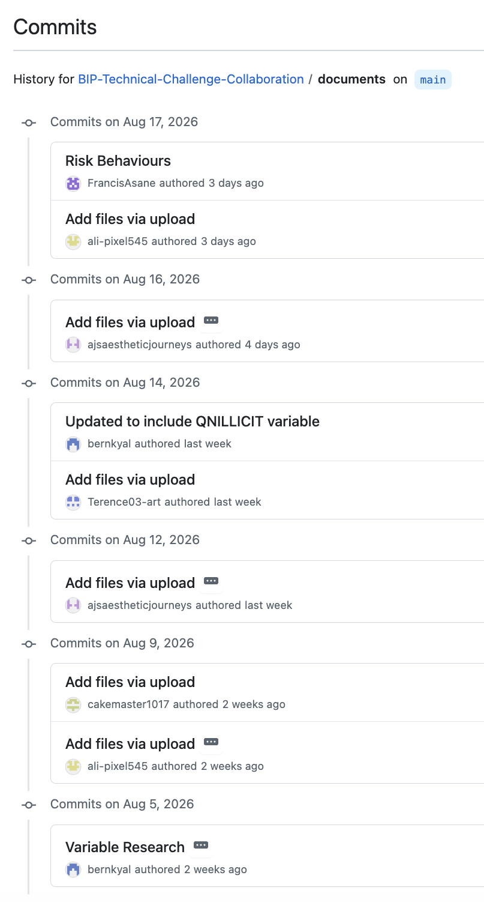
Reproducibility via GitHub
Everything lives in one place
All scripts, data, documentation, and outputs are tracked in a single public repository to see the full history of the project
Every change is logged and attributed
21 commits across the project, each with a description of what changed and who changed it (from variable selection to charts)
Structured for reproducibility
Separate folders for data, scripts, output, markdown, and documents the pipeline from raw data to final figures is traceable end to end.
Analysis can be re-run from scratch
Anyone can rebuild our results because the R scripts and outputs are version-controlled together

Slide 13
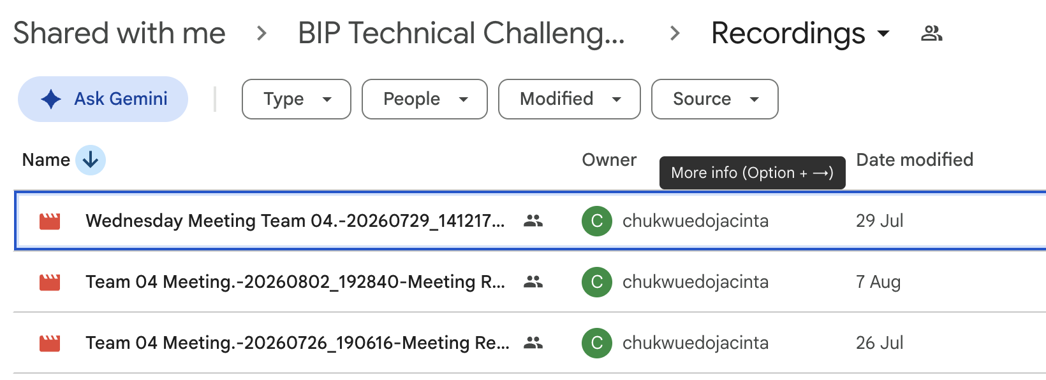
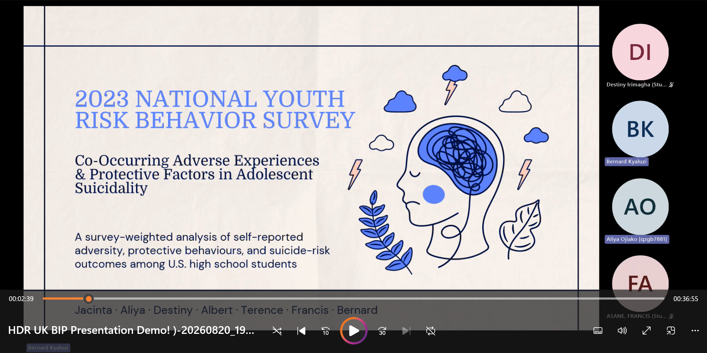
Collaboration via Google Drive & Teams

Slide 14
03
Key findings
A breakdown of key results across the four suicide outcomes

Slide 15
Compared our outcome variables to each of our selected variables

Slide 16
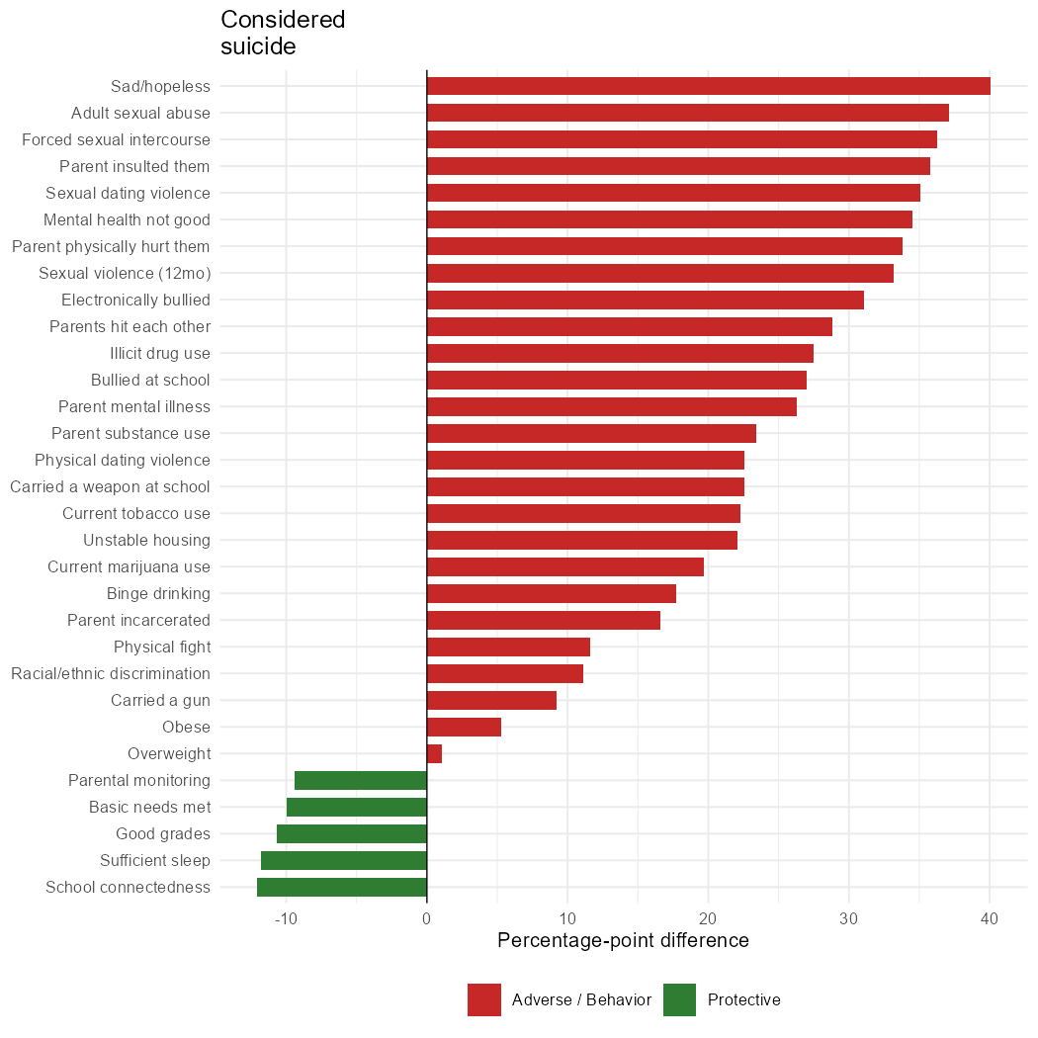
Cooccurrence
Sad/Hopelessness
Adult Sexual Abuse
Forced Sexual Intercourse
School connectedness
Sleep
Basics Needs Met

Slide 17
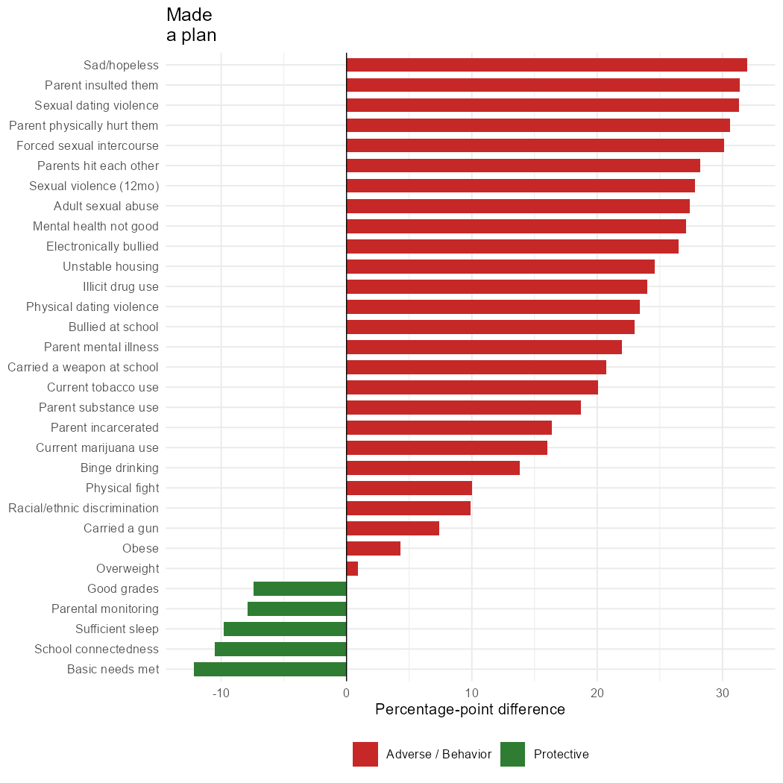
Cooccurrence
Sad/Hopelessness
Parents Insulted Them
Sexual Dating Violence
Basic Needs Met
School Connectedness
Sufficient Sleep

Slide 18
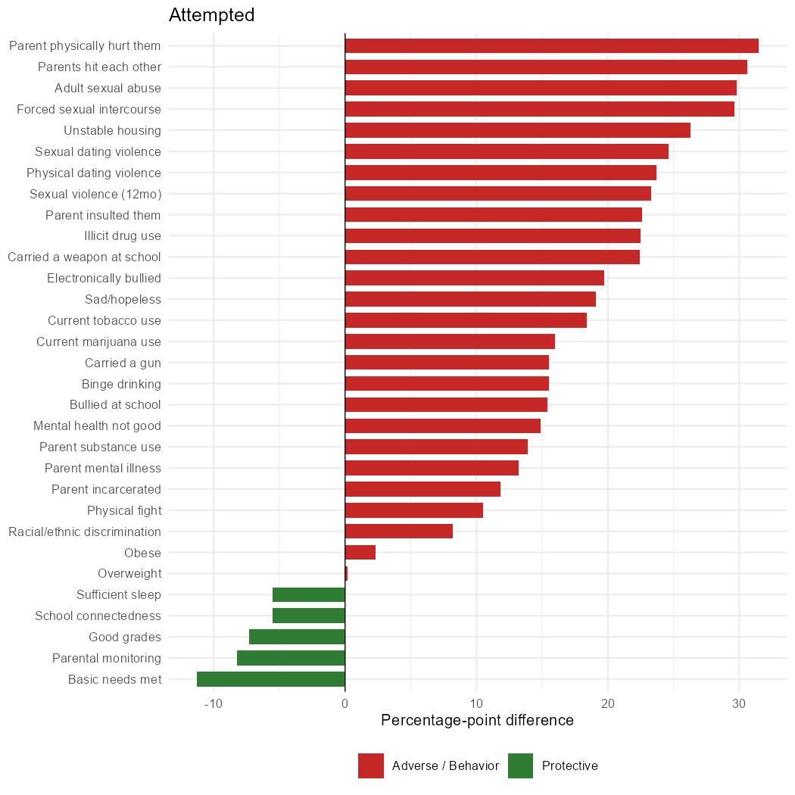
Cooccurrence
Parent’s physically hurt them
Parents hitting each other
Adult Sexual Abuse
Basic Needs Met
Parental monitoring
Good Grades

Slide 19
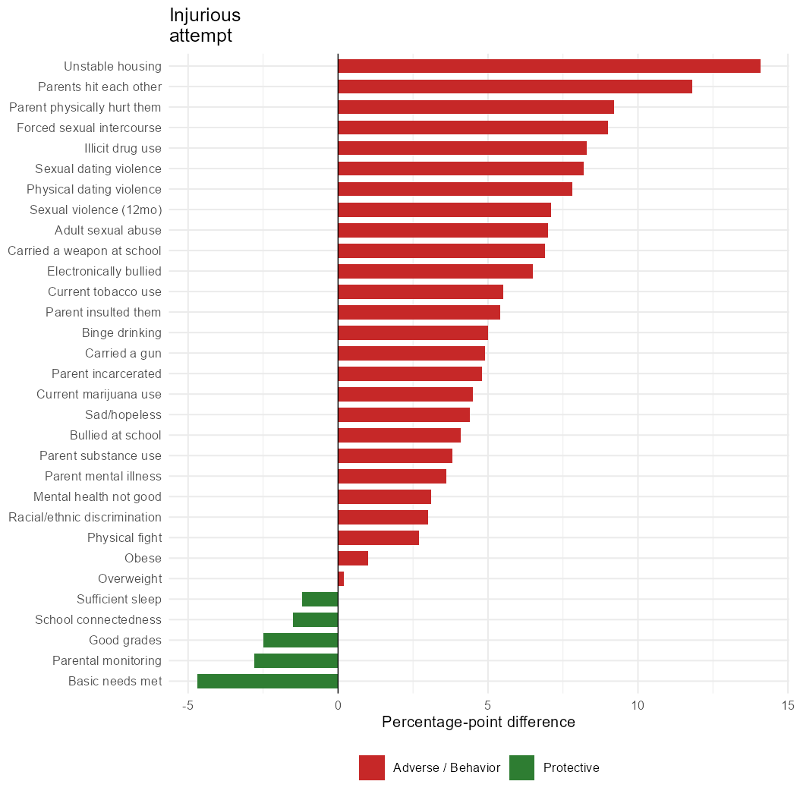
Cooccurrence
Unstable Housing
Parent’s hitting each other
Forced Sexual Intercourse
Basic Needs Met
Parental Monitoring
Good Grades

Slide 20
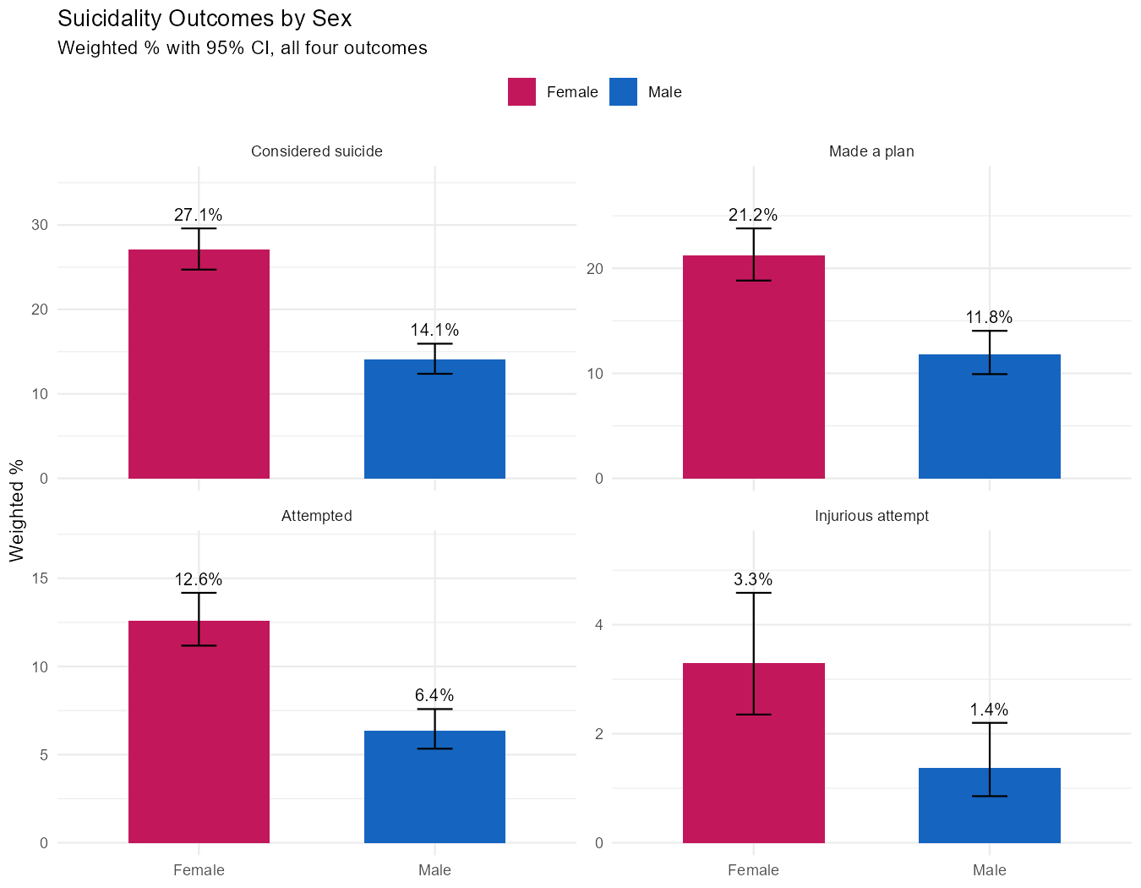
Demographics (Jacinta’s Variables)
Overall
Sex shows the strongest and most consistent demographic pattern in this dataset.
Female students report significantly higher prevalence than male students across all four outcomes
Composition
White 48.1%
Multi-Hispanic/Latino 19.8%
Black 13.3%
Hispanic 7.7%
Multi-non-Hispanic
6.1%
Asian 4.3%
Key findings
Race/ethnicity's relationship with suicidality is inconsistent across the four outcomes, statistically significant for considered suicide (p=0.003) and attempted suicide (p=0.008), but not significant for made a plan (p=0.100) or injurious attempt (p=0.082).

Slide 21
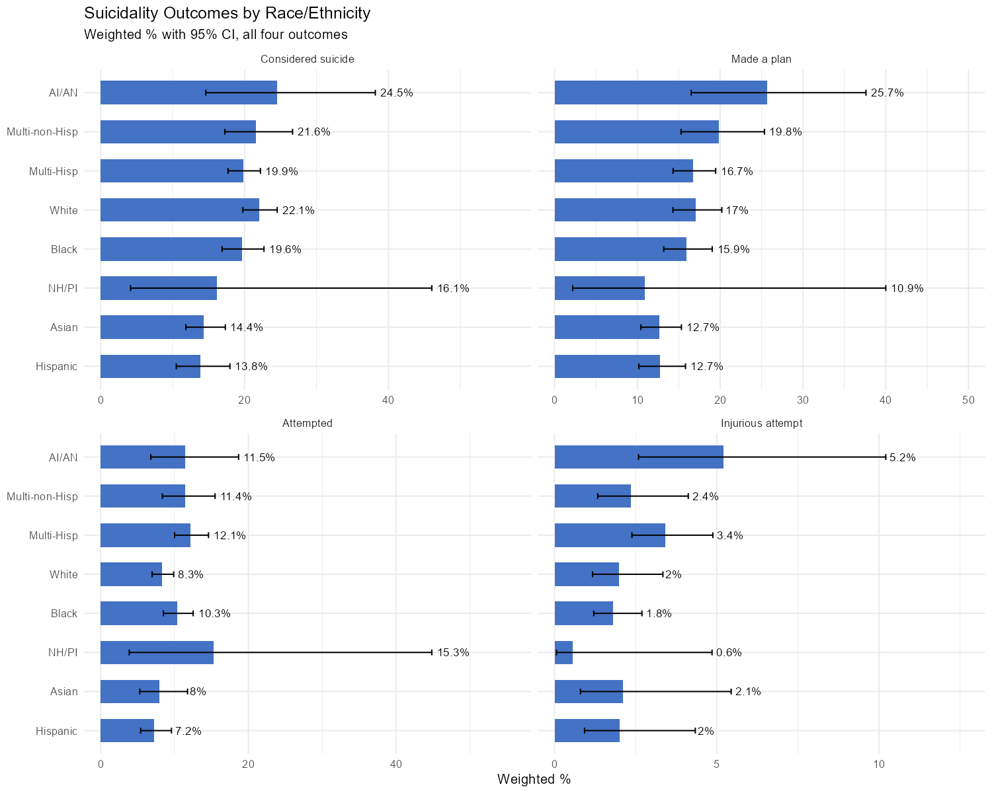

Slide 22
Aliya’s variables
HOLDS ACROSS
ALL 20 COMPARISONS
Every 1 of the 5 protective factors showed lower prevalence on every one of the 4 suicidality outcomes:
Considered
Planned
Attempted
Injured
Protective factors

Slide 23
Aliya’s variables (Protective factors)
Factor | CDC adjusted PR (2023 YRBS) | Our ratio (unadjusted) | Agreement
Sleep (QN85) | 0.53 - 0.67 | 0.48 - 0.49 | Close match
Basic needs met (QN99) | 0.41 - 0.80 | 0.23 - 0.66 | Close match
Parental monitoring (QN104) | 0.51 - 0.74 | 0.34 - 0.66 | Close match
School connectedness (QN103) | 0.63 - 0.70 | 0.52 - 0.56 | Close match
Grades (QN87) | Not tested by CDC | 0.34 - 0.66 | Consistent with outside literature
A ratio below 1.0 = lower risk in the protective-factor group. 0.53 ≈ roughly half the risk.
Sleep, basic needs, parental monitoring and school connectedness are the exact protective factors CDC selected for its own 2023 YRBS analysis: and our unadjusted ratios sit close to their adjusted ones.
Grades isn’t one of CDC’s six protective factors, so we drew on outside literature instead — directionally consistent, but the least consistently supported of the five across subgroups in the wider research.
Protective factors

Slide 24
04
Recommendations
A closer look at our dataset refinements and further analysis

Slide 25
Limitations
Direction and causality
This is cross-sectional, self-report data. We can't establish that a protective factor came before (or caused a change in) an outcome, only that they co-occur
Recall & reference periods
Different questions ask about “during your life,” “past 12 months,” and “past 30 days”.
These inconsistent windows can affect recall and comparability
Overlapping factors
Protective factors are interrelated (i.e., a well-monitored student may also sleep more), so this analysis can't isolate each factor's independent contribution
Unmeasured cofounders
Household socioeconomic status is known to shape both protective factors and mental health outcomes, however, isn’t captured in the YRBS

Slide 26
05
Conclusions
A summary of our conclusions, limitations, and next steps

Slide 27
Two sides of the same picture
Adverse experiences
Protective factors
Sexual & dating violence,
household dysfunction, school & community adversity, violence-adjacent behaviours each individually linked to higher suicide-risk indicators in prior research
↑ higher prevalence
Sleep, grades, basic needs met, school connectedness, parental monitoring, each associated with substantially lower prevalence of every suicidality outcome measured.
↓ lower prevalence

